Slide 1
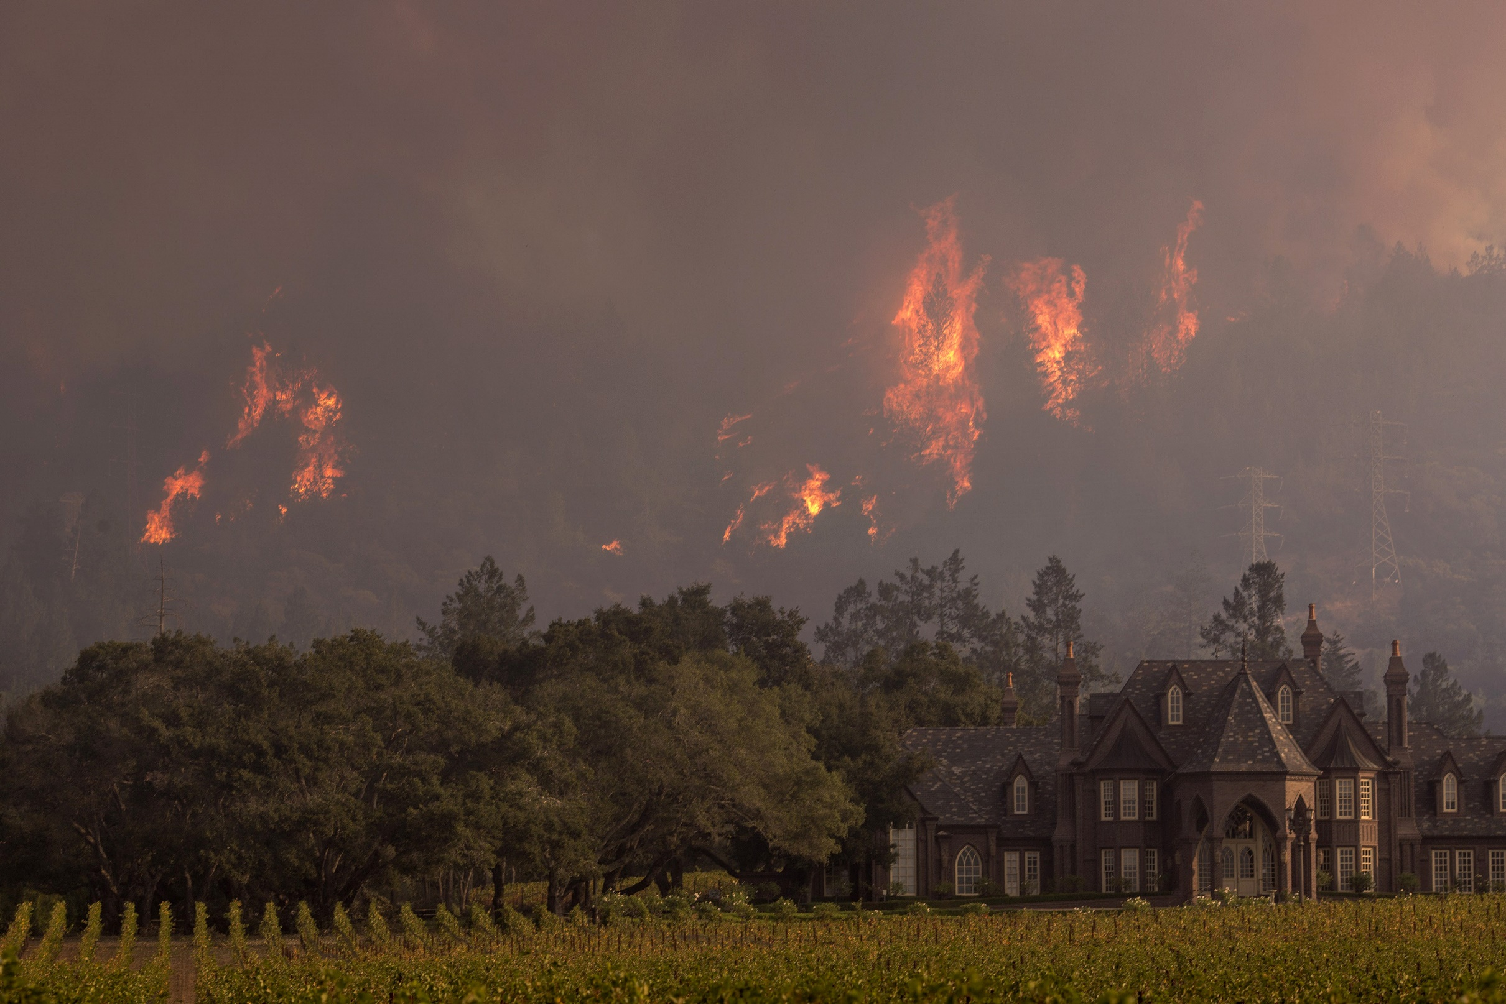
Changing Wildfire Conditions
By Matthew Johnson

Slide 2
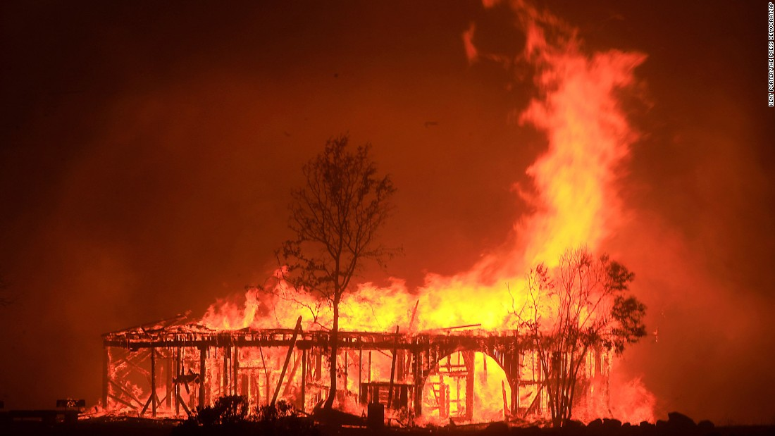
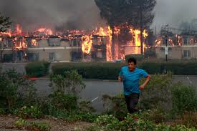
Statistics for California 2017
Fatalities: 1 firefighter, 45 civilians
8,900+ structures
$9.4 billion (2017)

Slide 3
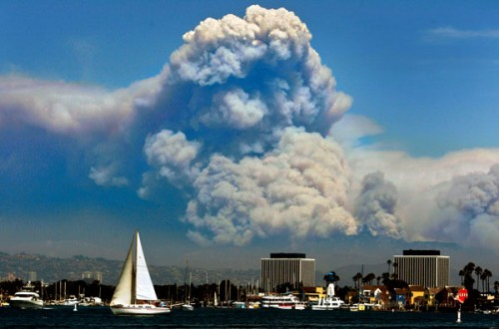
Overview
Wildfire Occurrence Statistics
  Where wildfires occur
  Seasonality of fires
  Trends in wildfire occurrence
How Does Weather Impact Fire?
Climate connections
  Indices of low frequency climate variations (ENSO)

Slide 4
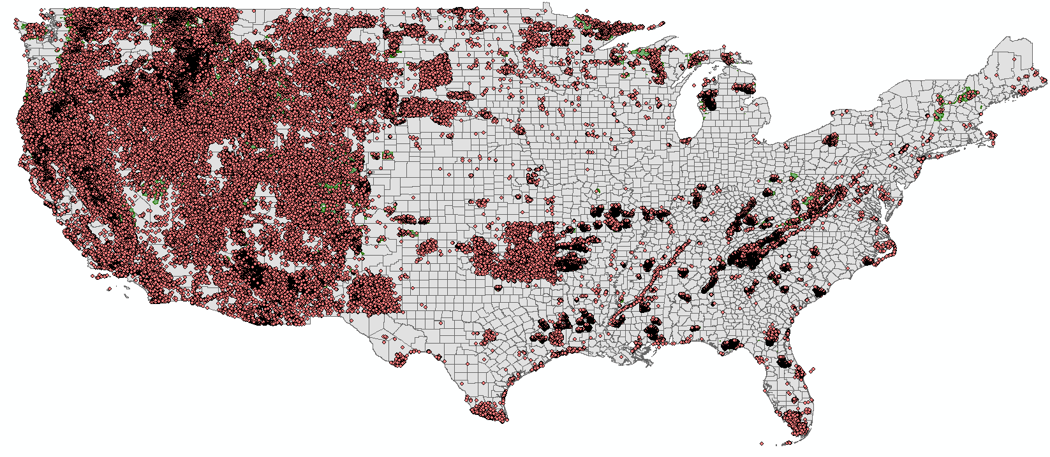
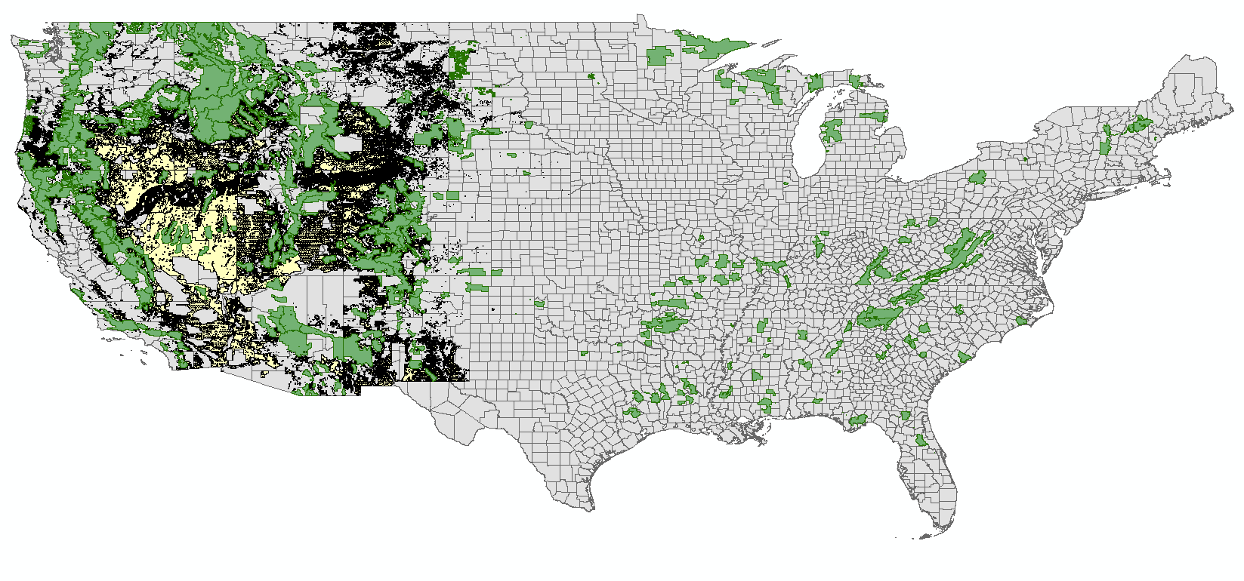
Data and Methodology
Wildfire Point Data Set from the USGS
  Location of all U.S. wildfires, with size, date, and other parameters
Eliminated incomplete data and fires under 1 acre.
Used ERAU software package to compare with gridded weather data from NOAA.
Wildfires in the point data set line up with the USFS and BLM boundaries.
GIS map of all USGS wildfire points
GIS map of USFS and BLM Boundaries

Slide 5
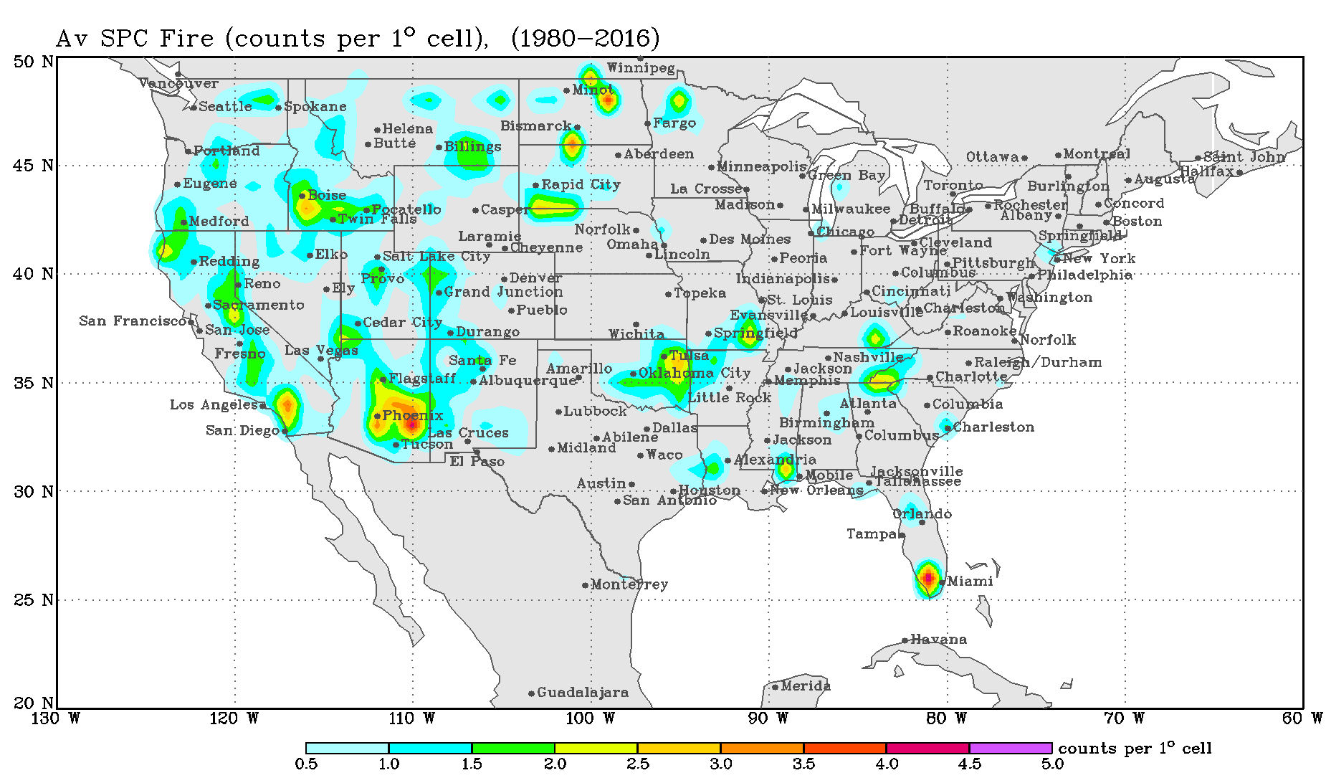
Wildfire Occurrence – all U.S. Wildfires 1980-2016

Slide 6
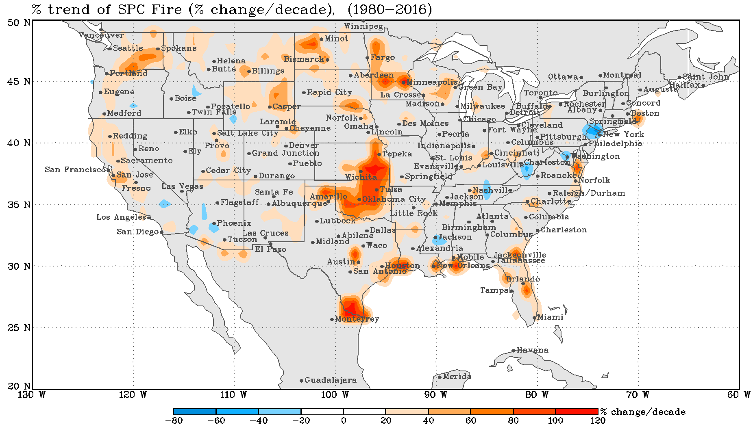
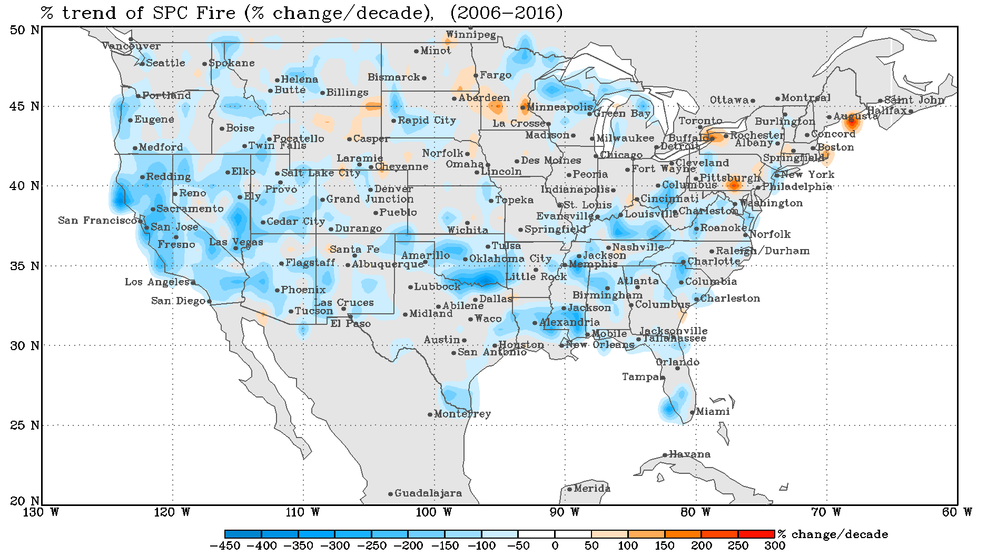
Wildfire Trends All Over the U.S.
But, decreasing in the current decade (2006-2016).
Wildfire incidence increasing in most places from 1980-2016

Slide 7
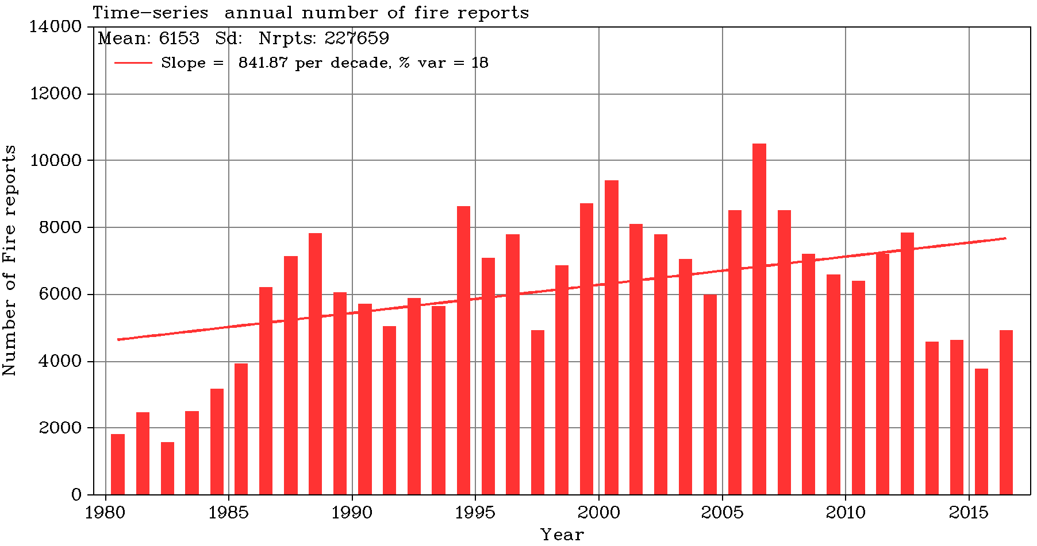
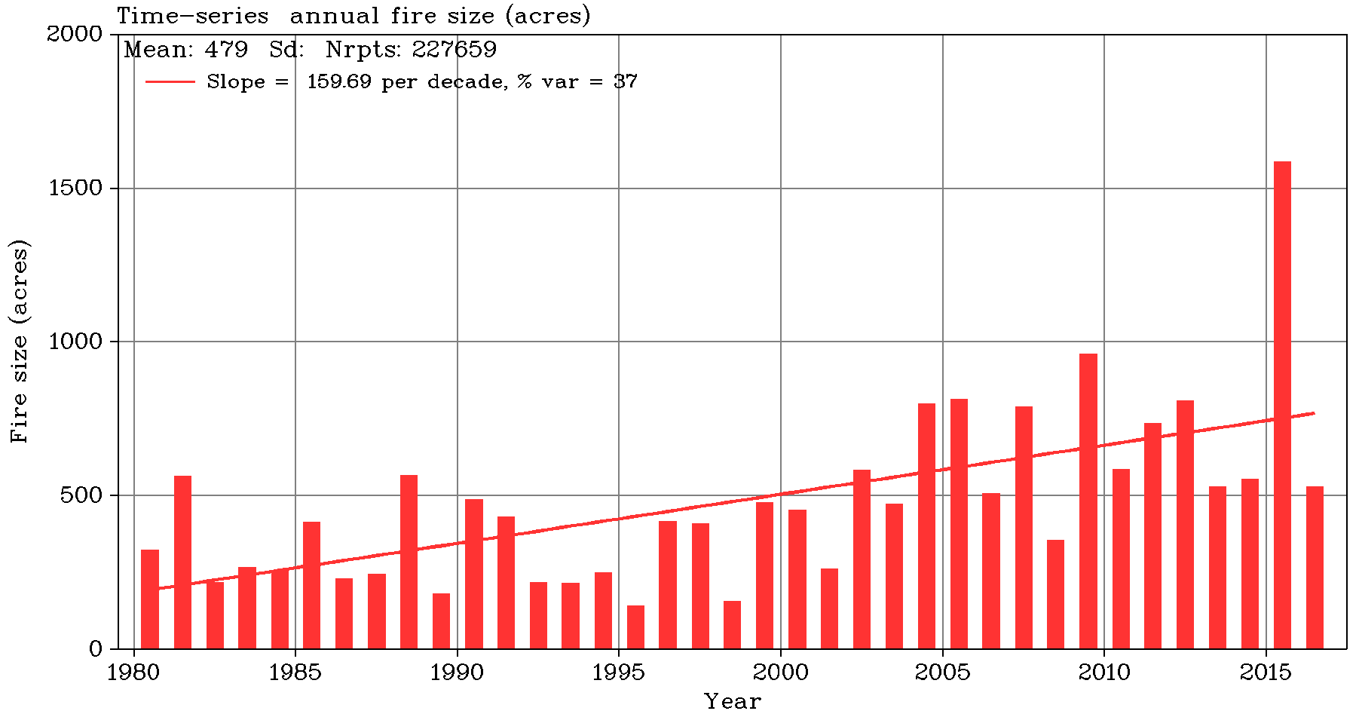
Trends Across the United States
Overall, wildfire occurrence across the U.S. is trending up.
Wildfire size is increasing.
Last the 10 years, the number of wildfires has been decreasing.
Number of Wildfires
Wildfire size
Note decrease current decade

Slide 8
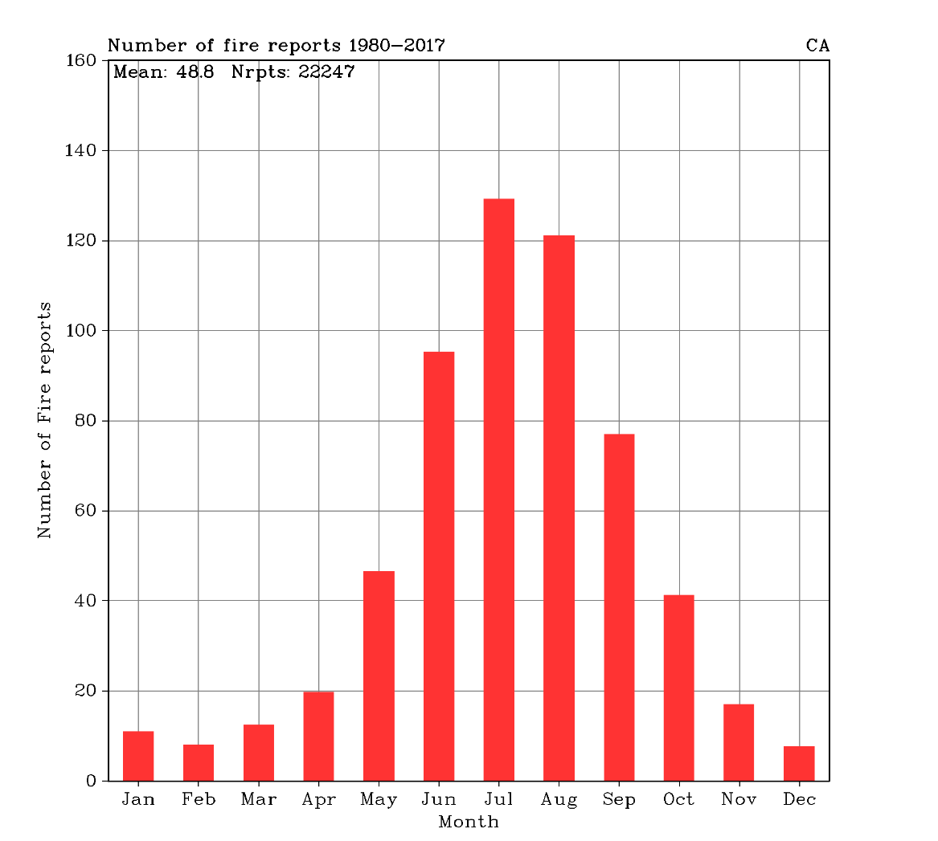
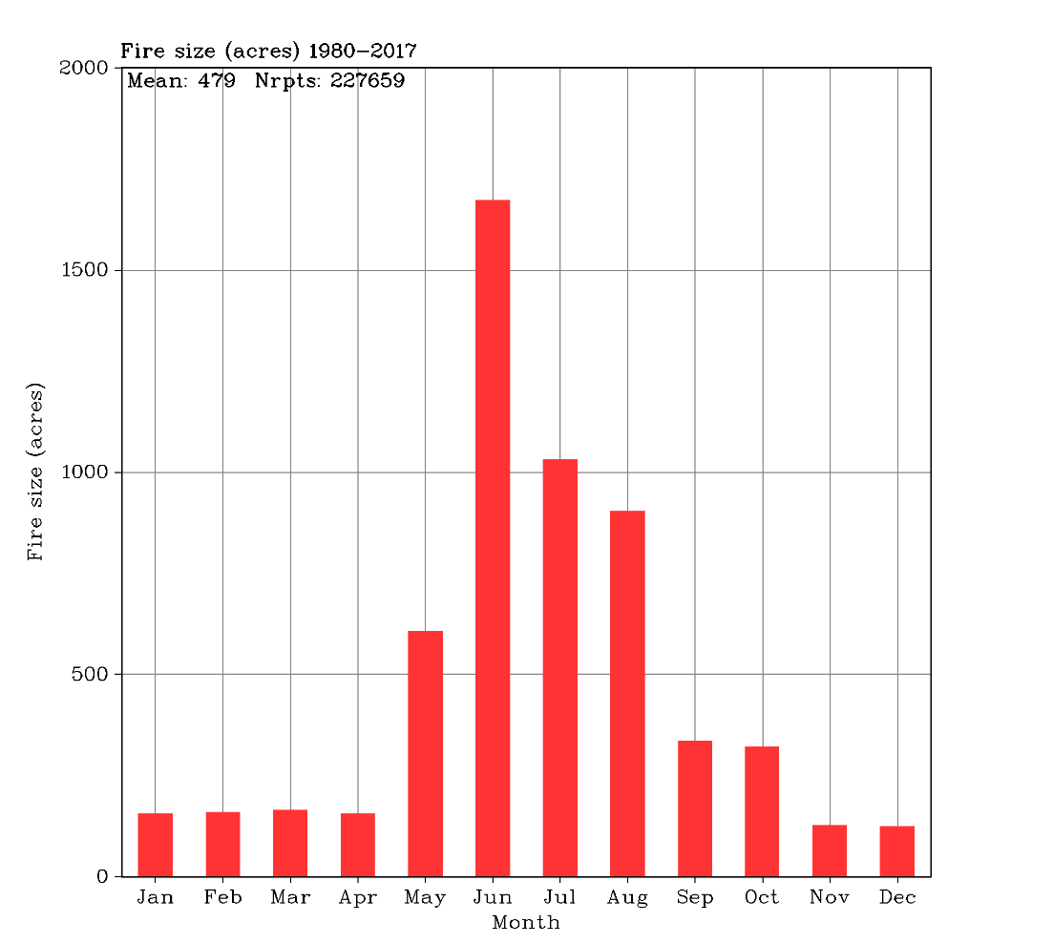
Wildfire Occurrence by month (all fires, all states)
Number of Fires
Size of fires (acres)
Most wildfires occur spring/summer
Largest wildfires summer/fall

Slide 9
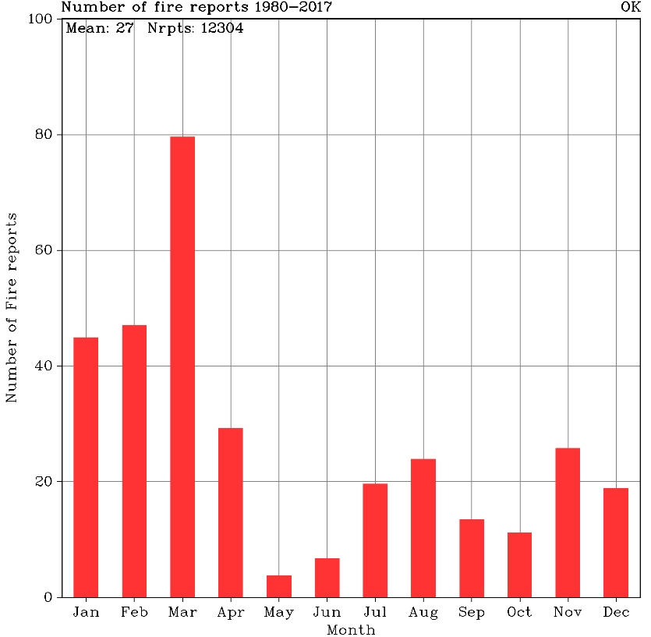
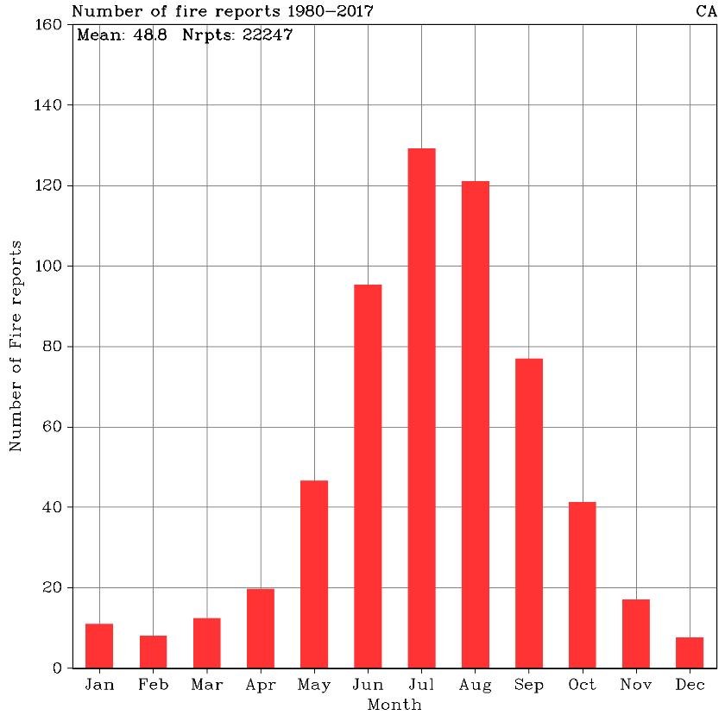
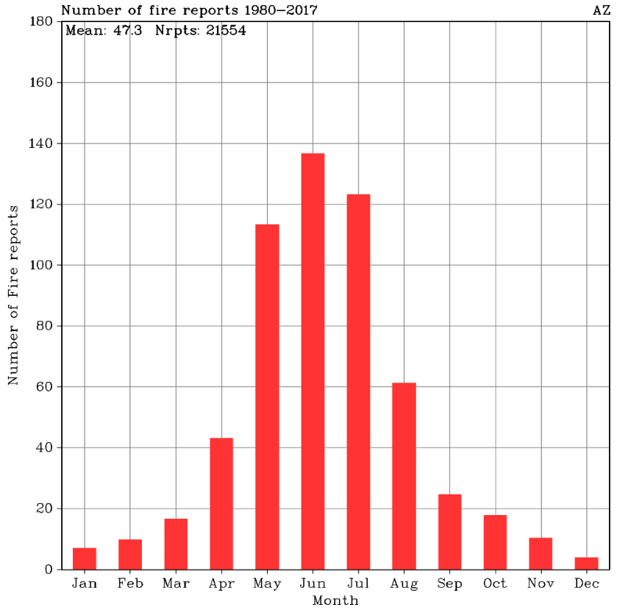
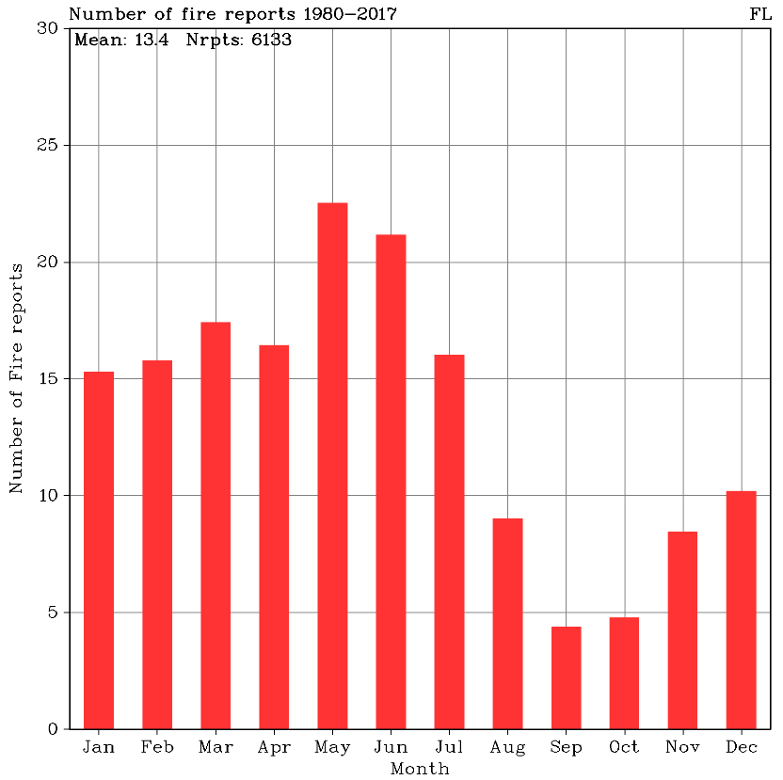
Are wildfire seasons different for diverse regions in the U.S.?
OK
YES! Note that Fire Seasons are different all across the United States.
CA
AZ
FL

Slide 10
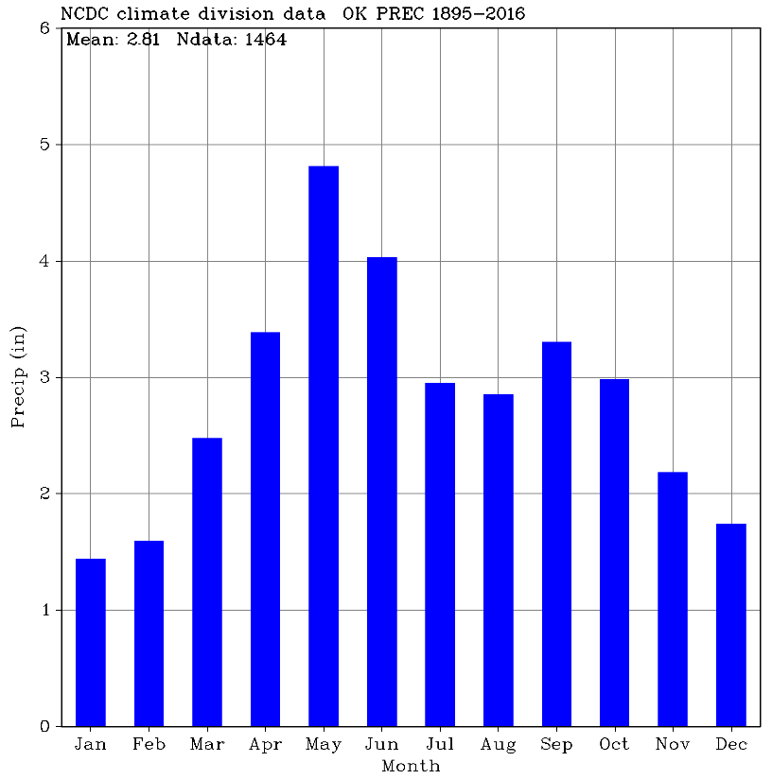
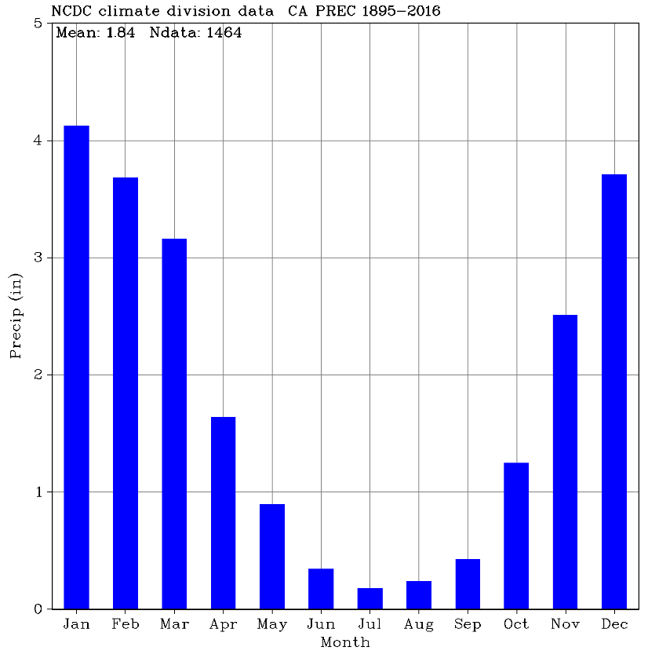
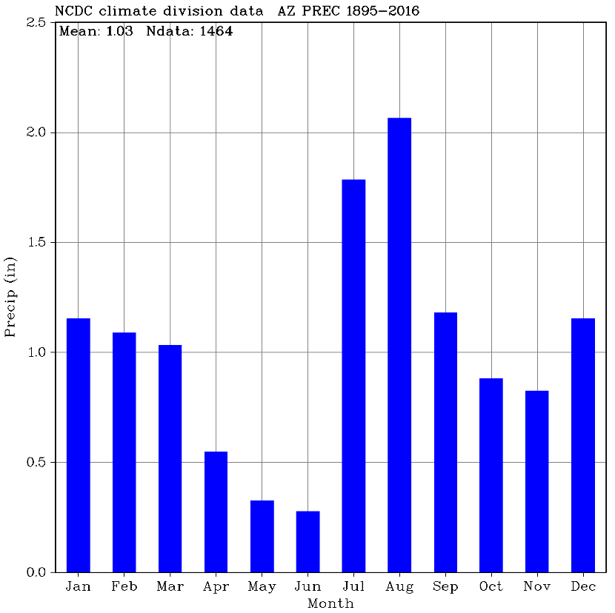
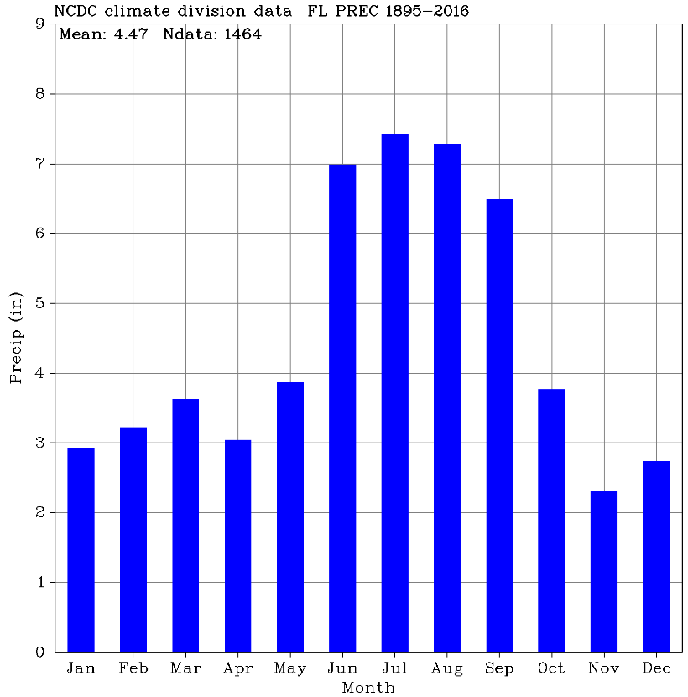
Precipitation for these four regions.
OK
Note that most wildfires occur at the end of the driest months
CA
AZ
FL

Slide 11
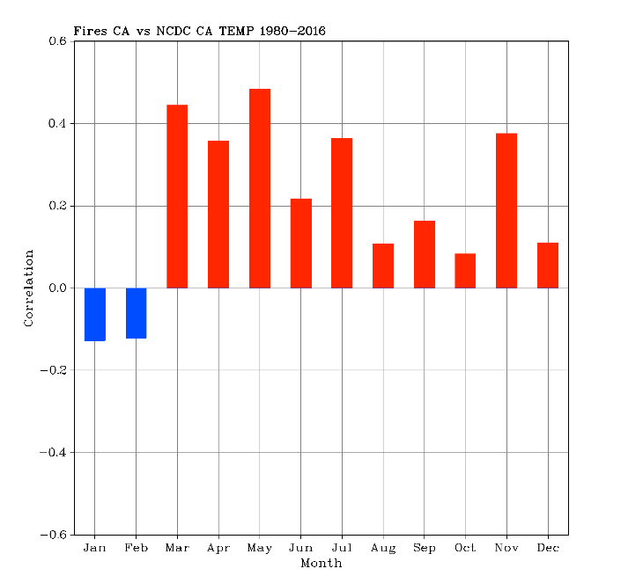
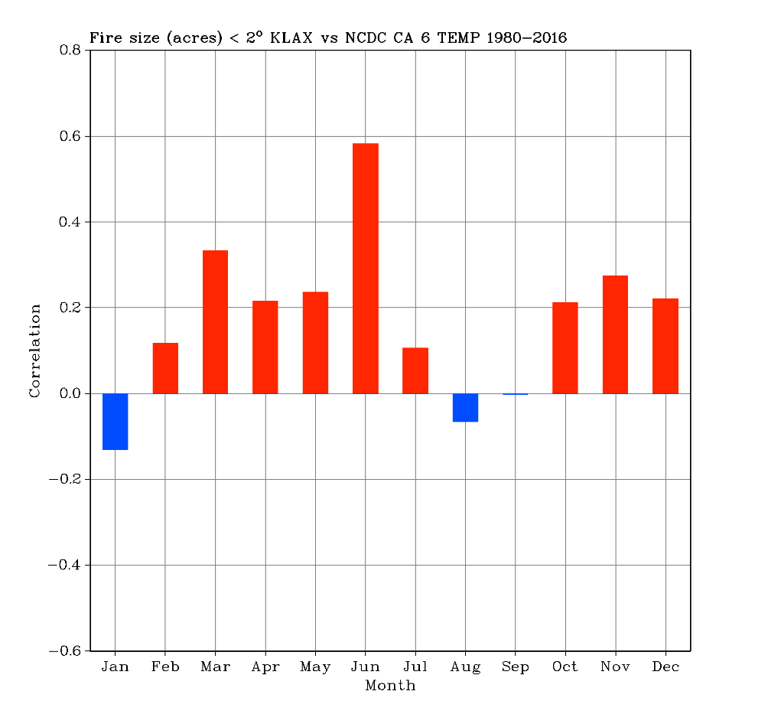
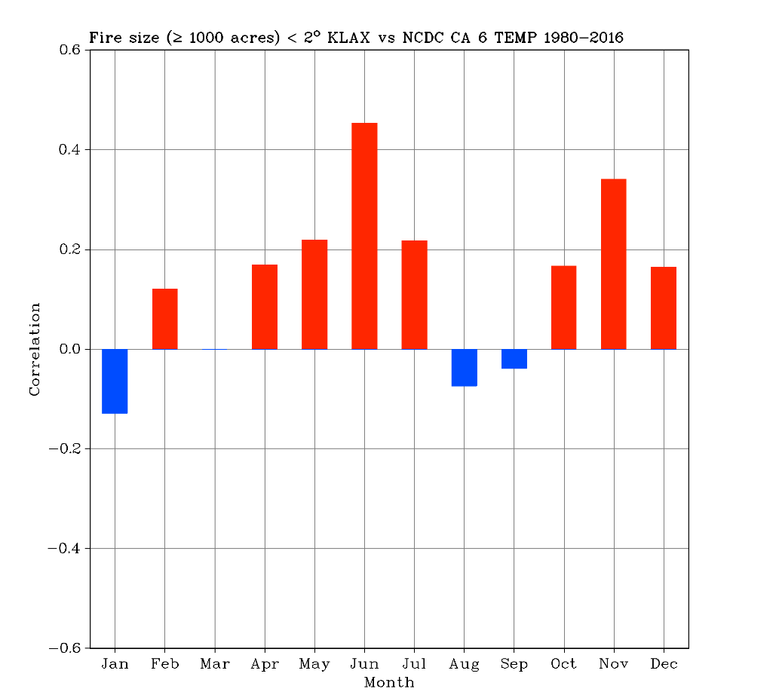
Correlations with Temperature in Southern CA
Number of fires correlated with temperature
Fire size in acres correlated with temperature
Fire Size above 1000 acres correlated with temperature
High temperature help wildfires by drying out fuels

Slide 12
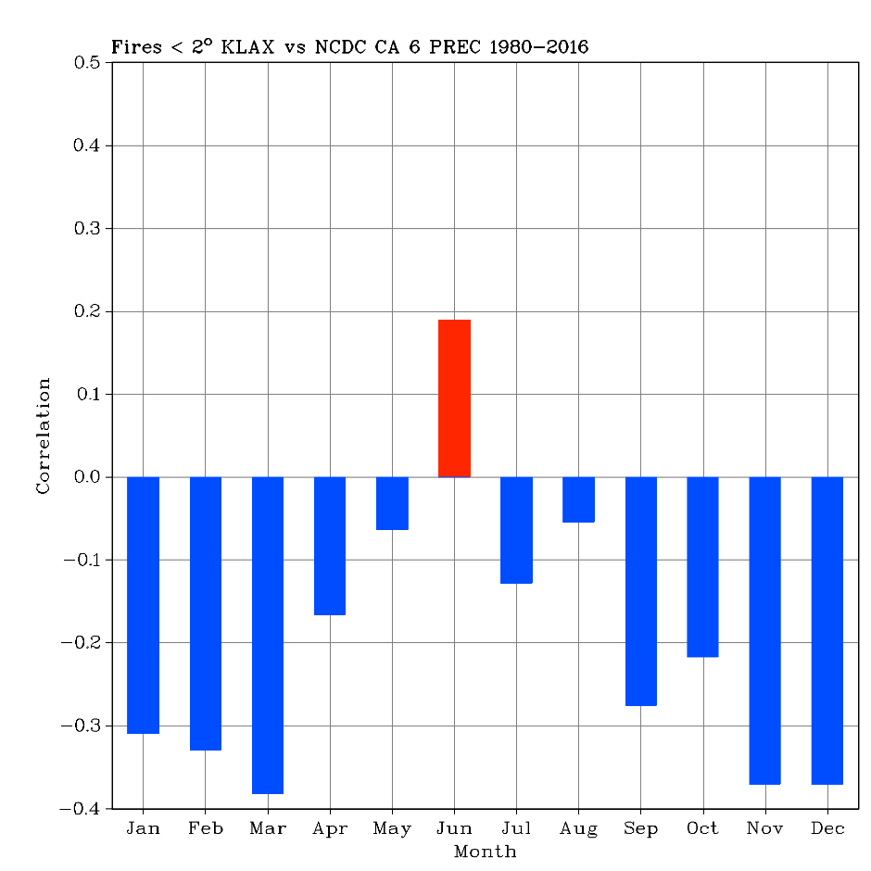
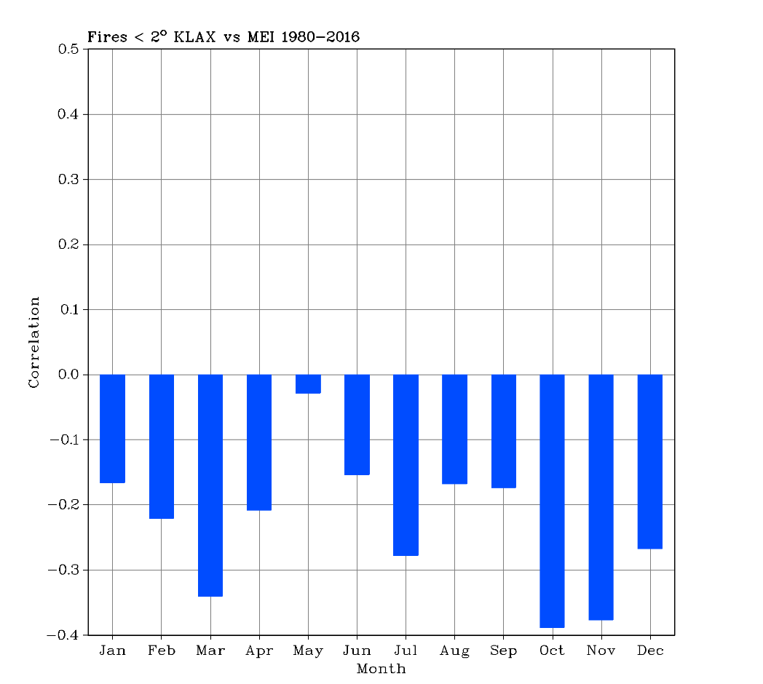
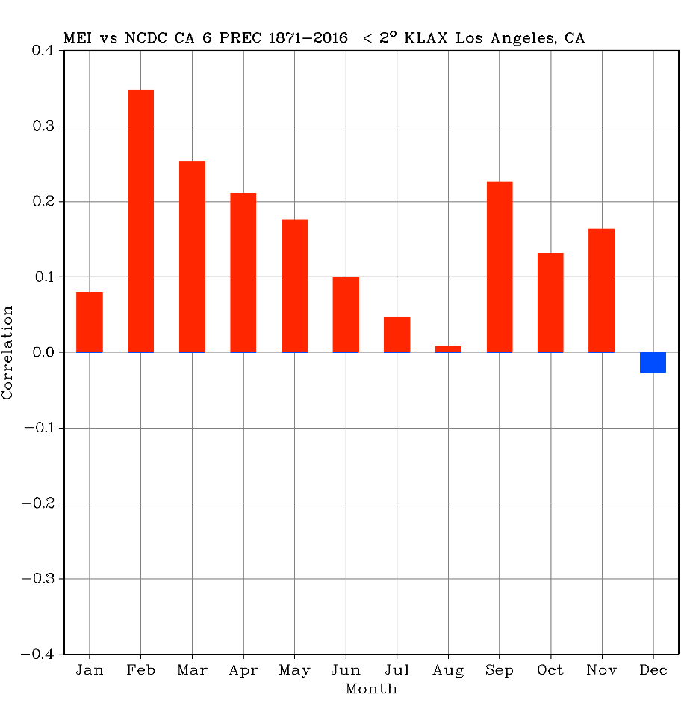
Correlations with ENSO (El Nino) in SOCAL
Surprising, but June precip < 0.4” and accompanied by lightning
Fires vs precipitation
- Precipitation hinders fires except in June
Fires vs ENSO
- La Nina favors fires
Precipitation vs ENSO
- El Nino favors winter rain
- La Nina favors winter drought

Slide 13
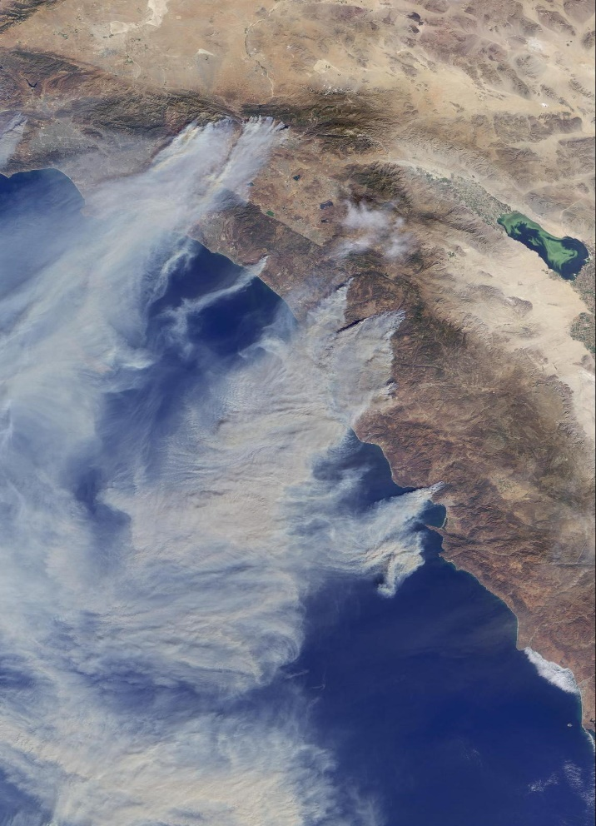
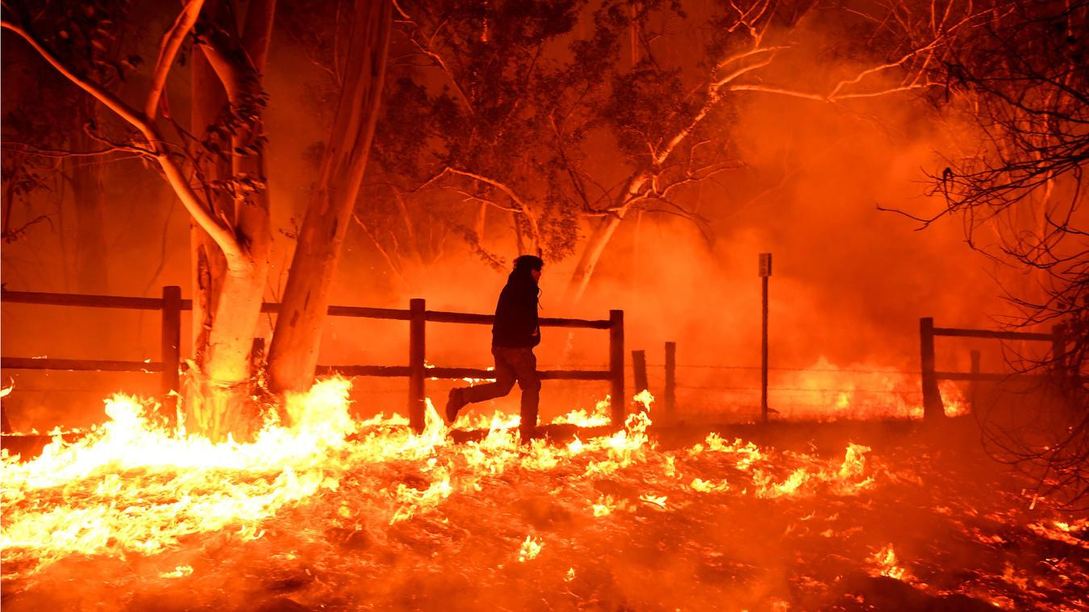
Which meteorological factors influence wildfire growth?
First , identify time of greatest wildfire growth
Create a composite (average) weather chart for these times

Slide 14
Fire Progression Map (ArcGIS)

Slide 15
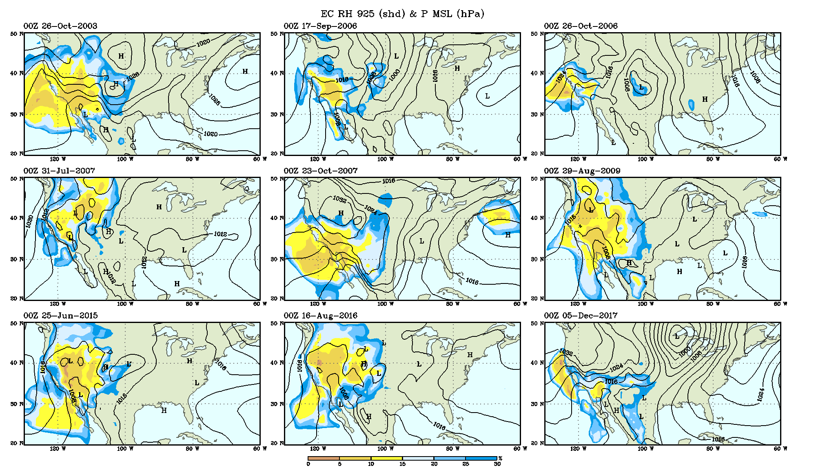
Weather Charts at Time of max Growth for Nine Major Wildfires
Composited weather for 9 major wildfires during the greatest rate of wildfire growth.

Slide 16
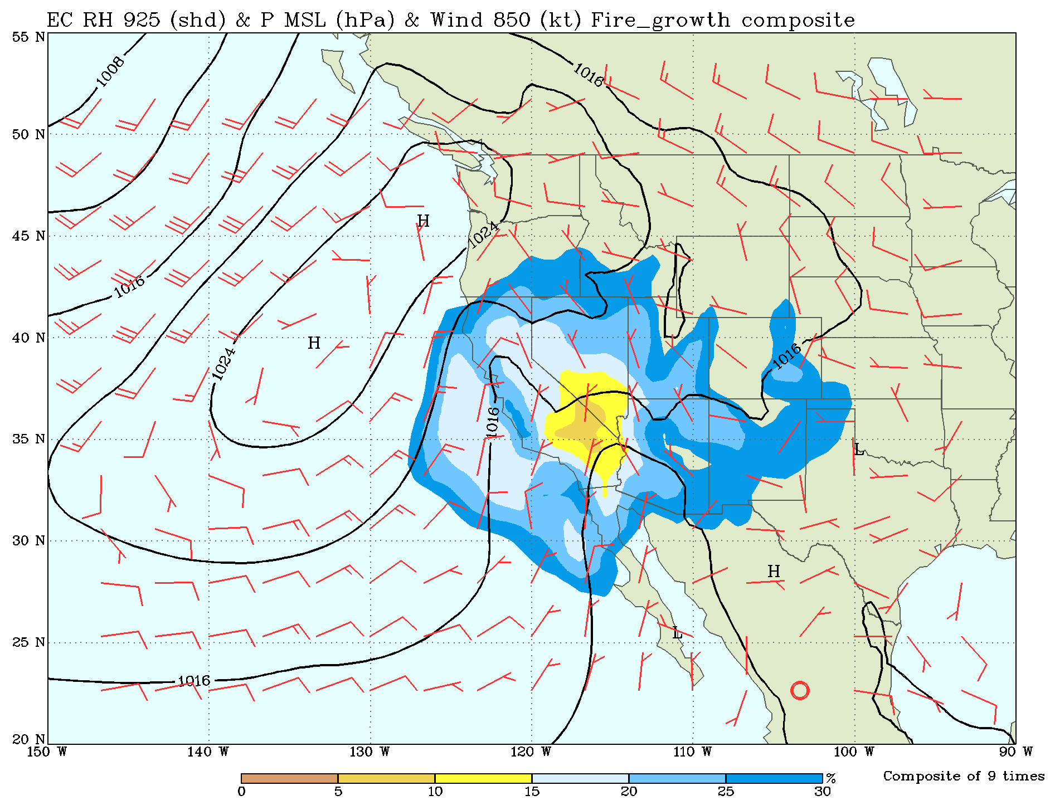
Composite of the Nine Wildfires
NE Santa Ana winds & low RH dominate over Southern California at time of maximum fire growth

Slide 17
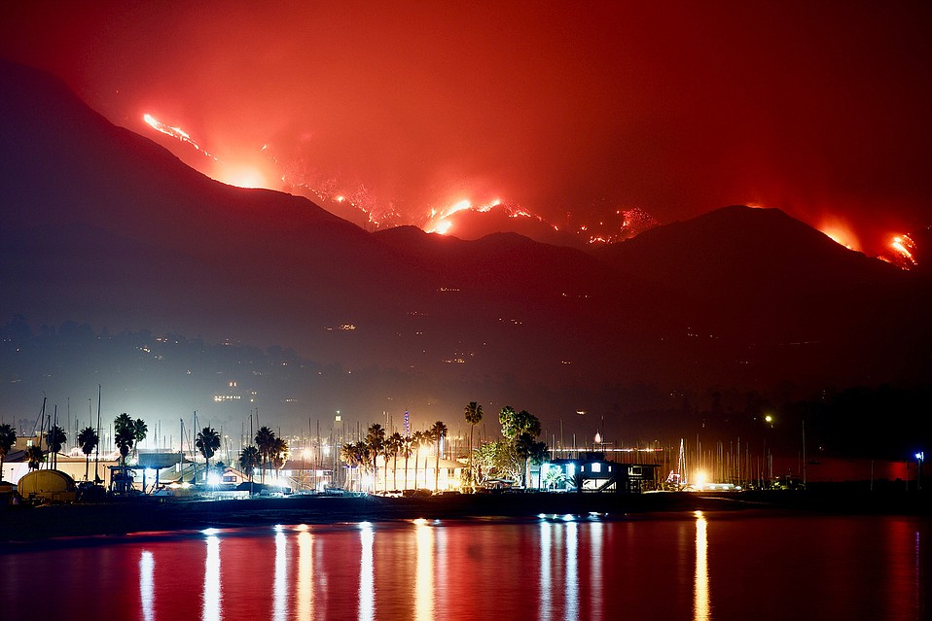
Summary and Conclusions
Wildfires are in increasing in size.
Wildfire numbers have been decreasing for the last 10 years.
High winds, high temperatures, and low RH contribute to wildfire incidence and growth.
Santa Ana conditions are the cause for the largest wildfires in Southern CA.

Slide 18
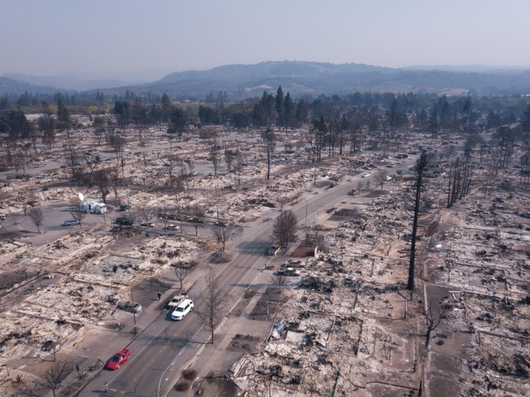
Questions?

Slide 19
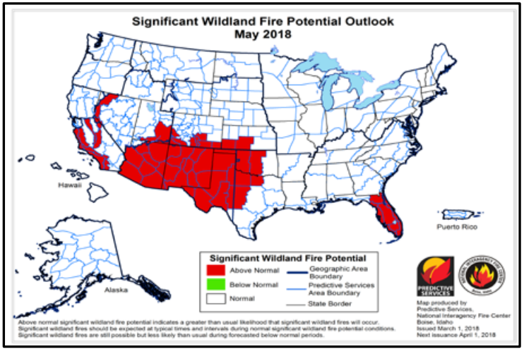
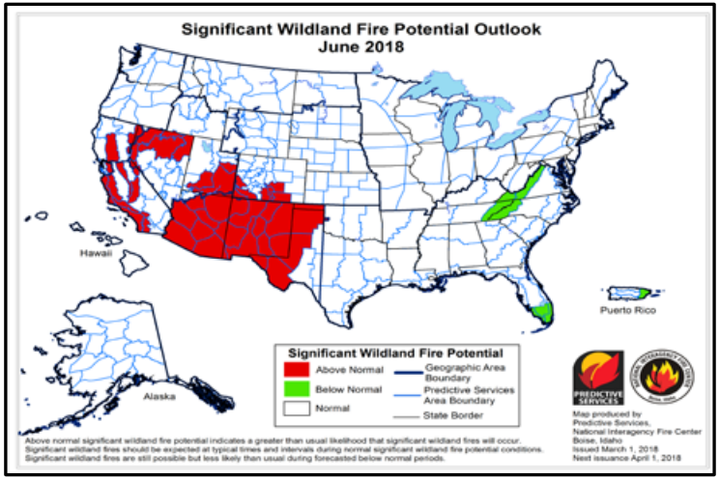
Prediction for Upcoming Fire Season
It’s La Nina
It’s been drier than normal, especially in AZ.
Official wildfire outlook by National Interagency Fire Center (NIFC)

Slide 20
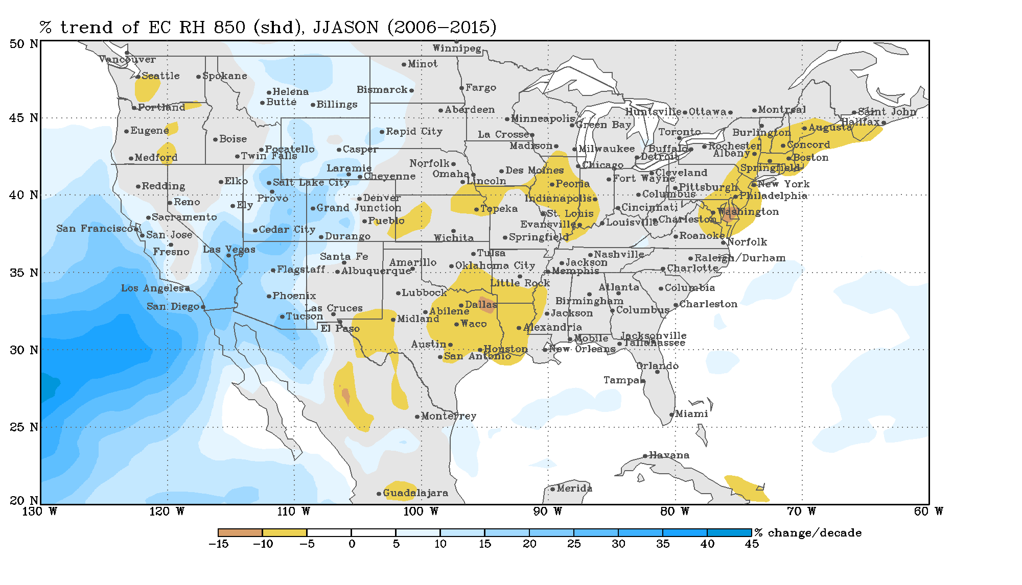
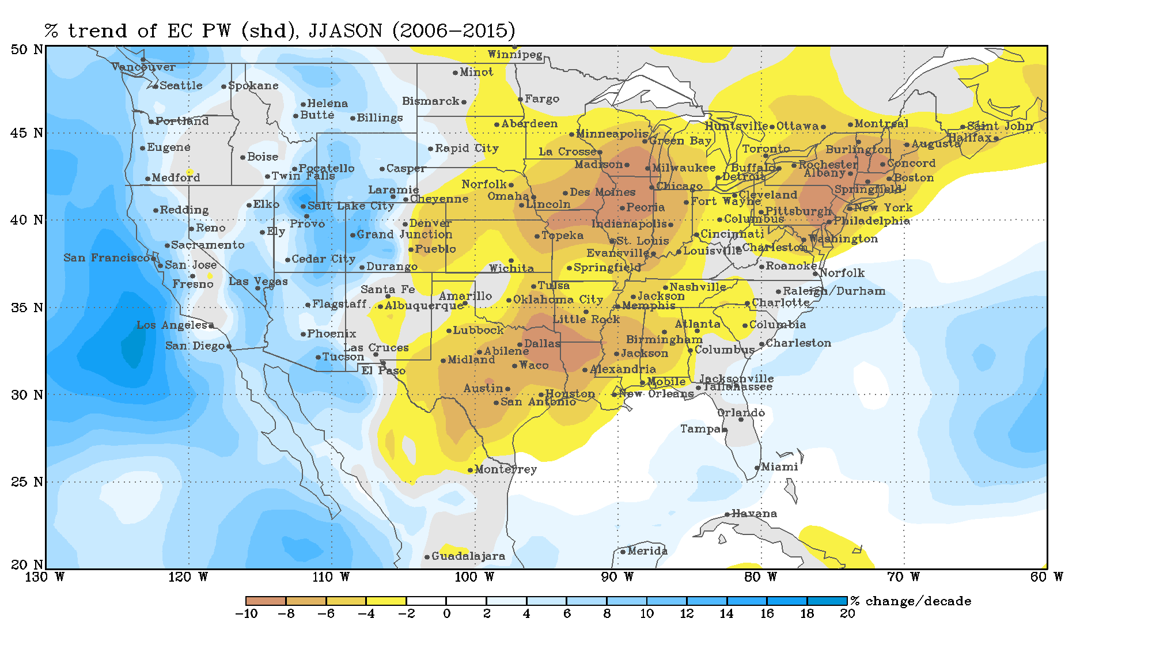
Reason for Decreasing Wildfires in the Last Decade
Relative Humidity
Precipitable Water

